Slide 1
Administrator Check-in Chat:
CLUB GROWTH & RECOGNITION
Monday, April 10, 2023

Slide 2
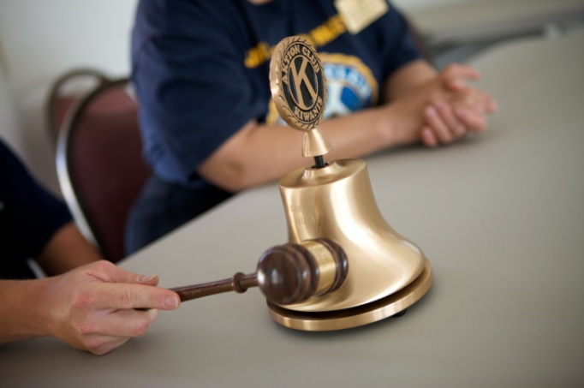
Starting New Clubs
Notes:
While there are many people that can get clubs started, District Administrators are the primary drivers responsible for opening and supporting new clubs through the chartering process and beyond.

Slide 3
DA Responsibilities
Identify potential host institutions (organizations, agencies) and share information on benefits of Aktion Club; follow-up for their decision.
Match potential hosts and local Kiwanis clubs; facilitate a meeting and encourage a relationship. [If a Kiwanis club is not available to sponsor, assist host institution with chartering and how to renew club annually. Inform KI of no Kiwanis sponsor.]
Welcome and check on new club advisors.
Notes:
As a DA you have many responsibilities. Related to club growth, these are new responsibilities. Remember that growth means adding clubs but you also want to make sure that new clubs are thriving, not struggling.

Slide 4
Needed to start a club
An organization serving adults with disabilities, library or community site that will host and provide a club advisor.
At least 15 adults with disabilities are needed to serve as members.
A sponsoring Kiwanis club (preferred): Pays fees and celebrates and/or partners on service projects.
Kiwanis advisor to assist with activities and be the liaison to the sponsoring Kiwanis club.
Host site agrees club will follow KI youth protection policies and use club’s program materials/resources for service and leadership.
Notes:
Finding a local Kiwanis club to sponsor a new Builders Club is preferred and usual. A host site may pay its own fees when Kiwanis sponsorship isn’t possible. We recommend at least 15 members in Builders Clubs. Hosts must agree that its club will follow KI policies.

Slide 5
Strategic places to grow clubs
Connect with local chapters of agencies that support adults with disabilities.
The Arc of the United States
Easterseals
College campus resources (Office of Accessible Education)
Notes:
Be intentional about spending your new club recruitment efforts strategically. Where K family lines are missing in school districts and communities and where clubs have been but are no longer active are two specific places to explore and build relationships.

Slide 6
Strategic places to grow clubs
Connect with state and city government agencies that offer resources to individuals with disabilities.
Example: The Aging & Disability Resource Center (ADRC) of Walworth County in Elkhorn, Wisconsin, lists Aktion Club as a resource.
There are ADRCs across the U.S. Find the ADRC in your state and ask about including your Aktion Club as one of their resources. Visit the following links to learn more.
Aging and Disability Resource Centers
Aging and Disability Networks
Notes:
Be intentional about spending your new club recruitment efforts strategically. Where K family lines are missing in school districts and communities and where clubs have been but are no longer active are two specific places to explore and build relationships.

Slide 7
Ask Kiwanis clubs to help
Promote Aktion Club during Kiwanis district convention. Share about Aktion Club and ask Kiwanis clubs to sponsor.
Write articles for inclusion in the Kiwanis District e-newsletter. Share about the benefits of sponsoring an Aktion Club.
Invite Kiwanis club members that are current or retired teachers to pitch creation of Aktion Clubs that will serve students with disabilities aging out of high school.
Notes:
Similarly, there are Kiwanis clubs that may be more ready to agree to sponsorship of an SLP.

Slide 8
Benefits of sponsoring Aktion Club
Kiwanians gain opportunities for meaningful service.
Provides a stronger connection and relationship to their community’s adults with disabilities and supporting agencies.
Builds the Kiwanis club’s visibility and leadership in the community.
Notes:
Similarly, administrators can help Kiwanis clubs understand the substantial benefits they will gain from sponsoring and being involved with an SLP club! Sponsorships can make more connections for the Kiwanians to their local community, raise their club’s profile and provide opportunities for intergenerational service partnerships.

Slide 9








Aktion Club benefits the community
Fill real needs and improve communities by contributing time and resources.
Raise awareness about community needs and social issues.
Help organizations connect to agencies that serve adults with disabilities as well as with the adults who use their services.
Notes:
When you have conversations about creating new clubs with schools and other potential partner institutions, listen to the partners’ goals and match these with what Builders Club offers. Often this conversation will involve sharing the benefits youth gain from participation in Builders Club and the meaningful and substantial benefits the club (and school/organization) brings to the community. Particularly, there are the real contributions of time and physical resources a Builders Club makes that better many different community needs and raise awareness about them.

Slide 10
Cost of sponsoring an Aktion Club
  Chartering fees in USD (without banner)
    North America/Caribbean & Tier A: $400
    Tier B: $300
    Tier C: $200
  Annual dues for Aktion Club
    North America/Caribbean: $8 per member
    Tier A (outside NA/C): $8 per member
    Tier B and C (outside NA/C): $8 per member
Notes:
These are the costs for starting and maintaining a Builders Club. The cost for countries beyond North America and the Caribbean depend on which Tier they fall under. Clubs outside the U.S., Canada and the Caribbean do not receive program materials after their initial charter kit.
Bring Up Grades, or BUG, recognizes elementary students who raise their grades or maintain good grades from one grading period to the next.
Students are motivated to achieve because they set their own goals and participate in peer mentoring, which involves everyone in their success.
When they reach their goals, the entire class celebrates. Kiwanis clubs and members are key to ensuring that the students feel supported in their efforts and recognized appropriately for their achievements.

Slide 11

How Kiwanis supports Aktion Clubs
Dedicated staff develop Aktion Club programming
Monthly advisor
e-newsletters.
Website resources.
Youth Protection training and background checks for Kiwanis volunteers & club advisors.
Data collection to improve programs.
Liability insurance coverage for clubs.
Advisor training.
Creation of annual Aktion Club advisor and member materials.
Notes:
Kiwanis International supports Builders Club with all of the following items that are made possible through the charter and annual renewal fees paid by sponsoring Kiwanis clubs!
Dedicated staff that develops club resources and programming.
Builders Club program kit with resources sent to clubs annually.
Builders Club website offers current resources.
Online advisor training is offered each year.
Monthly e-newsletter for advisors.
Special events, like a new global club connection event coming next year.

Slide 12
Let’s chat
Where have you found the most interest in starting new clubs in your district?
What have been your biggest challenges in your work to start clubs?
What support, resources and tools do you need?
Other thoughts?

Slide 13

Awards and Recognition
Awesome!
Notes:
While there are many people that can get clubs started, District Administrators are the primary drivers responsible for opening and supporting new clubs through the chartering process and beyond.

Slide 14
Award opportunities
  Club participation
  Scrapbook
  Single Service
  Club video
  Annual Achievement Report (Distinguished Club/Honor Club)
  Member participation
  Speech
  Poster
Notes:
While there are many people that can get clubs started, District Administrators are the primary drivers responsible for opening and supporting new clubs through the chartering process and beyond.

Slide 15
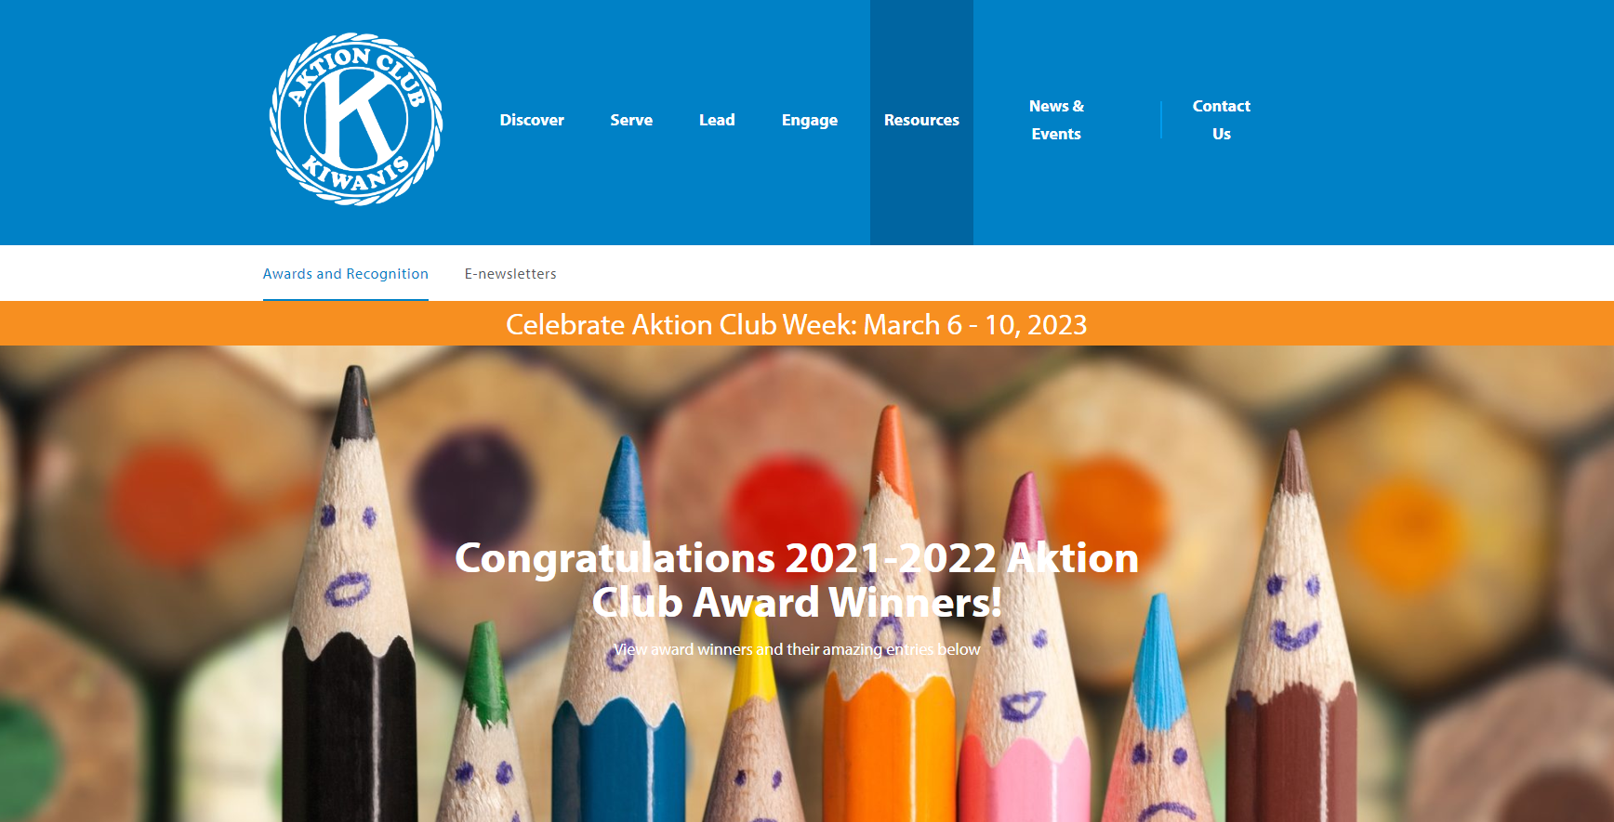
Award entries are submitted online!
Notes:
Remind your club advisors and share information with them about upcoming award opportunities. All award submissions must be completed online using the proper award forms. For awards information, visit the Builders Club website at www.buildersclub.org/awards-and-recognition.

Slide 16
April: First things first
Clubs are asked to create a YouTube or Vimeo account where Aktion Club award entries can be posted, viewed and shared. This is a great way to promote the Aktion Club.
Distribute and collect signed photo releases at the beginning of the year so permission is provided to share visuals of Aktion Club members photographed and filmed.
Notes:
Remind advisors to make sure to distribute consent releases at the beginning of the year, so that any photos they take of Builders Club members can be included in award submission entries and in social media posts by the club and district. Photo consent releases can be found in the Builders Club Advisor Guide and online on at BuildersClub.org/advisors

Slide 17
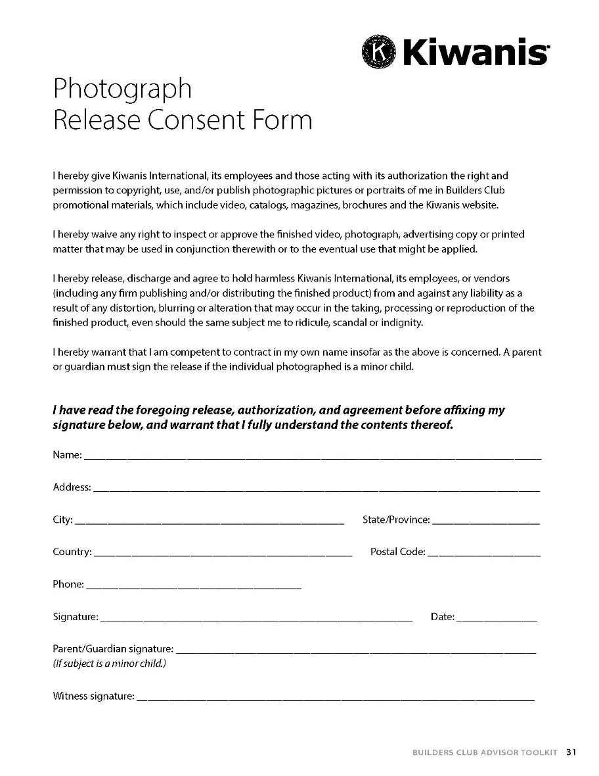
Photo releases
Releases are posted on AktionClub.org/advisors
Notes:
Remind advisors to make sure to distribute consent releases at the beginning of the year, so that any photos they take of Builders Club members can be included in award submission entries and in social media posts by the club and district. Photo consent releases can be found in the Builders Club Advisor Guide and online on at BuildersClub.org/advisors

Slide 18
May
Club advisors review and share award opportunities with club members.
The club establishes an Awards and Recognition Committee to work on award preparation and to share award progress.
May - August
The club finishes award submissions and uploads entries to the club’s YouTube or Vimeo account so links are available to share with online award submissions.
Notes:
Remind advisors to make sure to distribute consent releases at the beginning of the year, so that any photos they take of Builders Club members can be included in award submission entries and in social media posts by the club and district. Photo consent releases can be found in the Builders Club Advisor Guide and online on at BuildersClub.org/advisors

Slide 19
September
September 15: Clubs submit award entries.
November
November 2: A spreadsheet with links to award submissions are shared with district administrators for judging.
November 15: District administrators complete award judging noting winning entries on award spreadsheets.
Notes:
Remind advisors to make sure to distribute consent releases at the beginning of the year, so that any photos they take of Builders Club members can be included in award submission entries and in social media posts by the club and district. Photo consent releases can be found in the Builders Club Advisor Guide and online on at BuildersClub.org/advisors

Slide 20
December - January
Electronic recognition is forwarded to Aktion Club facility advisors.
Award winners are announced in the December Aktion Club e-newsletter, on the website and through social media outlets.
Notes:
Remind advisors to make sure to distribute consent releases at the beginning of the year, so that any photos they take of Builders Club members can be included in award submission entries and in social media posts by the club and district. Photo consent releases can be found in the Builders Club Advisor Guide and online on at BuildersClub.org/advisors

Slide 21
How recognition is shared
Digital award recognition
Award recognition is provided digitally. Letters, certificates and electronic badges are posted online for download.
Determine how to distribute recognitions:
  email a digital copy
  print to present or mail a hard copy
  share a link for recipients and their families to download recognition themselves.
Award recipients are posted on the Aktion Club website and shared in the monthly e-newsletter and social media.
Notes:
Award recognition is provided digitally. Presenter and recognition letters, certificates and electronic badges are all posted online for easy download. This provides the option of downloading and emailing recognition, printing and mailing a hard copy, or sharing the link and allowing the recipient(s) to download recognition is provided. Award recipients are listed on the Builders Club website and shared in the monthly e-newsletter and social media.

Slide 22
Annual Achievement Report
Your club can be recognized as either a Distinguished Club or an Honor Club based on the number of points it earns from responses to the report’s questions.
Earn 13 to 16 points → Distinguished Club
Earn 10 – 12 points → Honor Club
Notes:
Points earned on Annual Achievement Report influence recognition. 15 points or more = Distinguished Club, 10 – 14 points = Honor Club

Slide 23
Annual Achievement Report
Sample Report Questions
Did your incoming Aktion Club officers receive training?
Did your Aktion Club participate in Kiwanis Family activities?
Did the club submit a news story to the Kiwanis club, district or local newspaper?
Did your club participate in Aktion Club awards and recognition?
Did your club conduct one or more service projects that benefited an organization that serves adults with disabilities?
Notes:
These are some of the questions asked on the Annual Achievement Report. In the questions, clubs can see the kind of effective practices and activities we encourage clubs to do.

Slide 24

Any
questions?

Slide 25

Thank you!
Luana Nisan
SLP Manager
lnissan@kiwanis.org
Lisa J. Pyron
SLP Development Specialist
lpyron@kiwanis.org
Notes:
Kiwanis staff are always available to help. Here are our email addresses. Also, this PowerPoint and many resources for administrators are available at: www.buildersclub.org/district-administrator/

Slide 26
Thank you!

