Slide 1

Advisor Chat:
May 20, 2026

Slide 2
Rules
Clubs must be in good standing – all members’ dues paid.
Clubs can submit only one (1) entry per category.
Signed ‘Photograph Release Consent’ forms must be submitted for all members in photographs or videos.
Award and contest entries must be submitted using the online entry form.
All submissions are due by September 15, 11:59 p.m., ET.

Slide 3
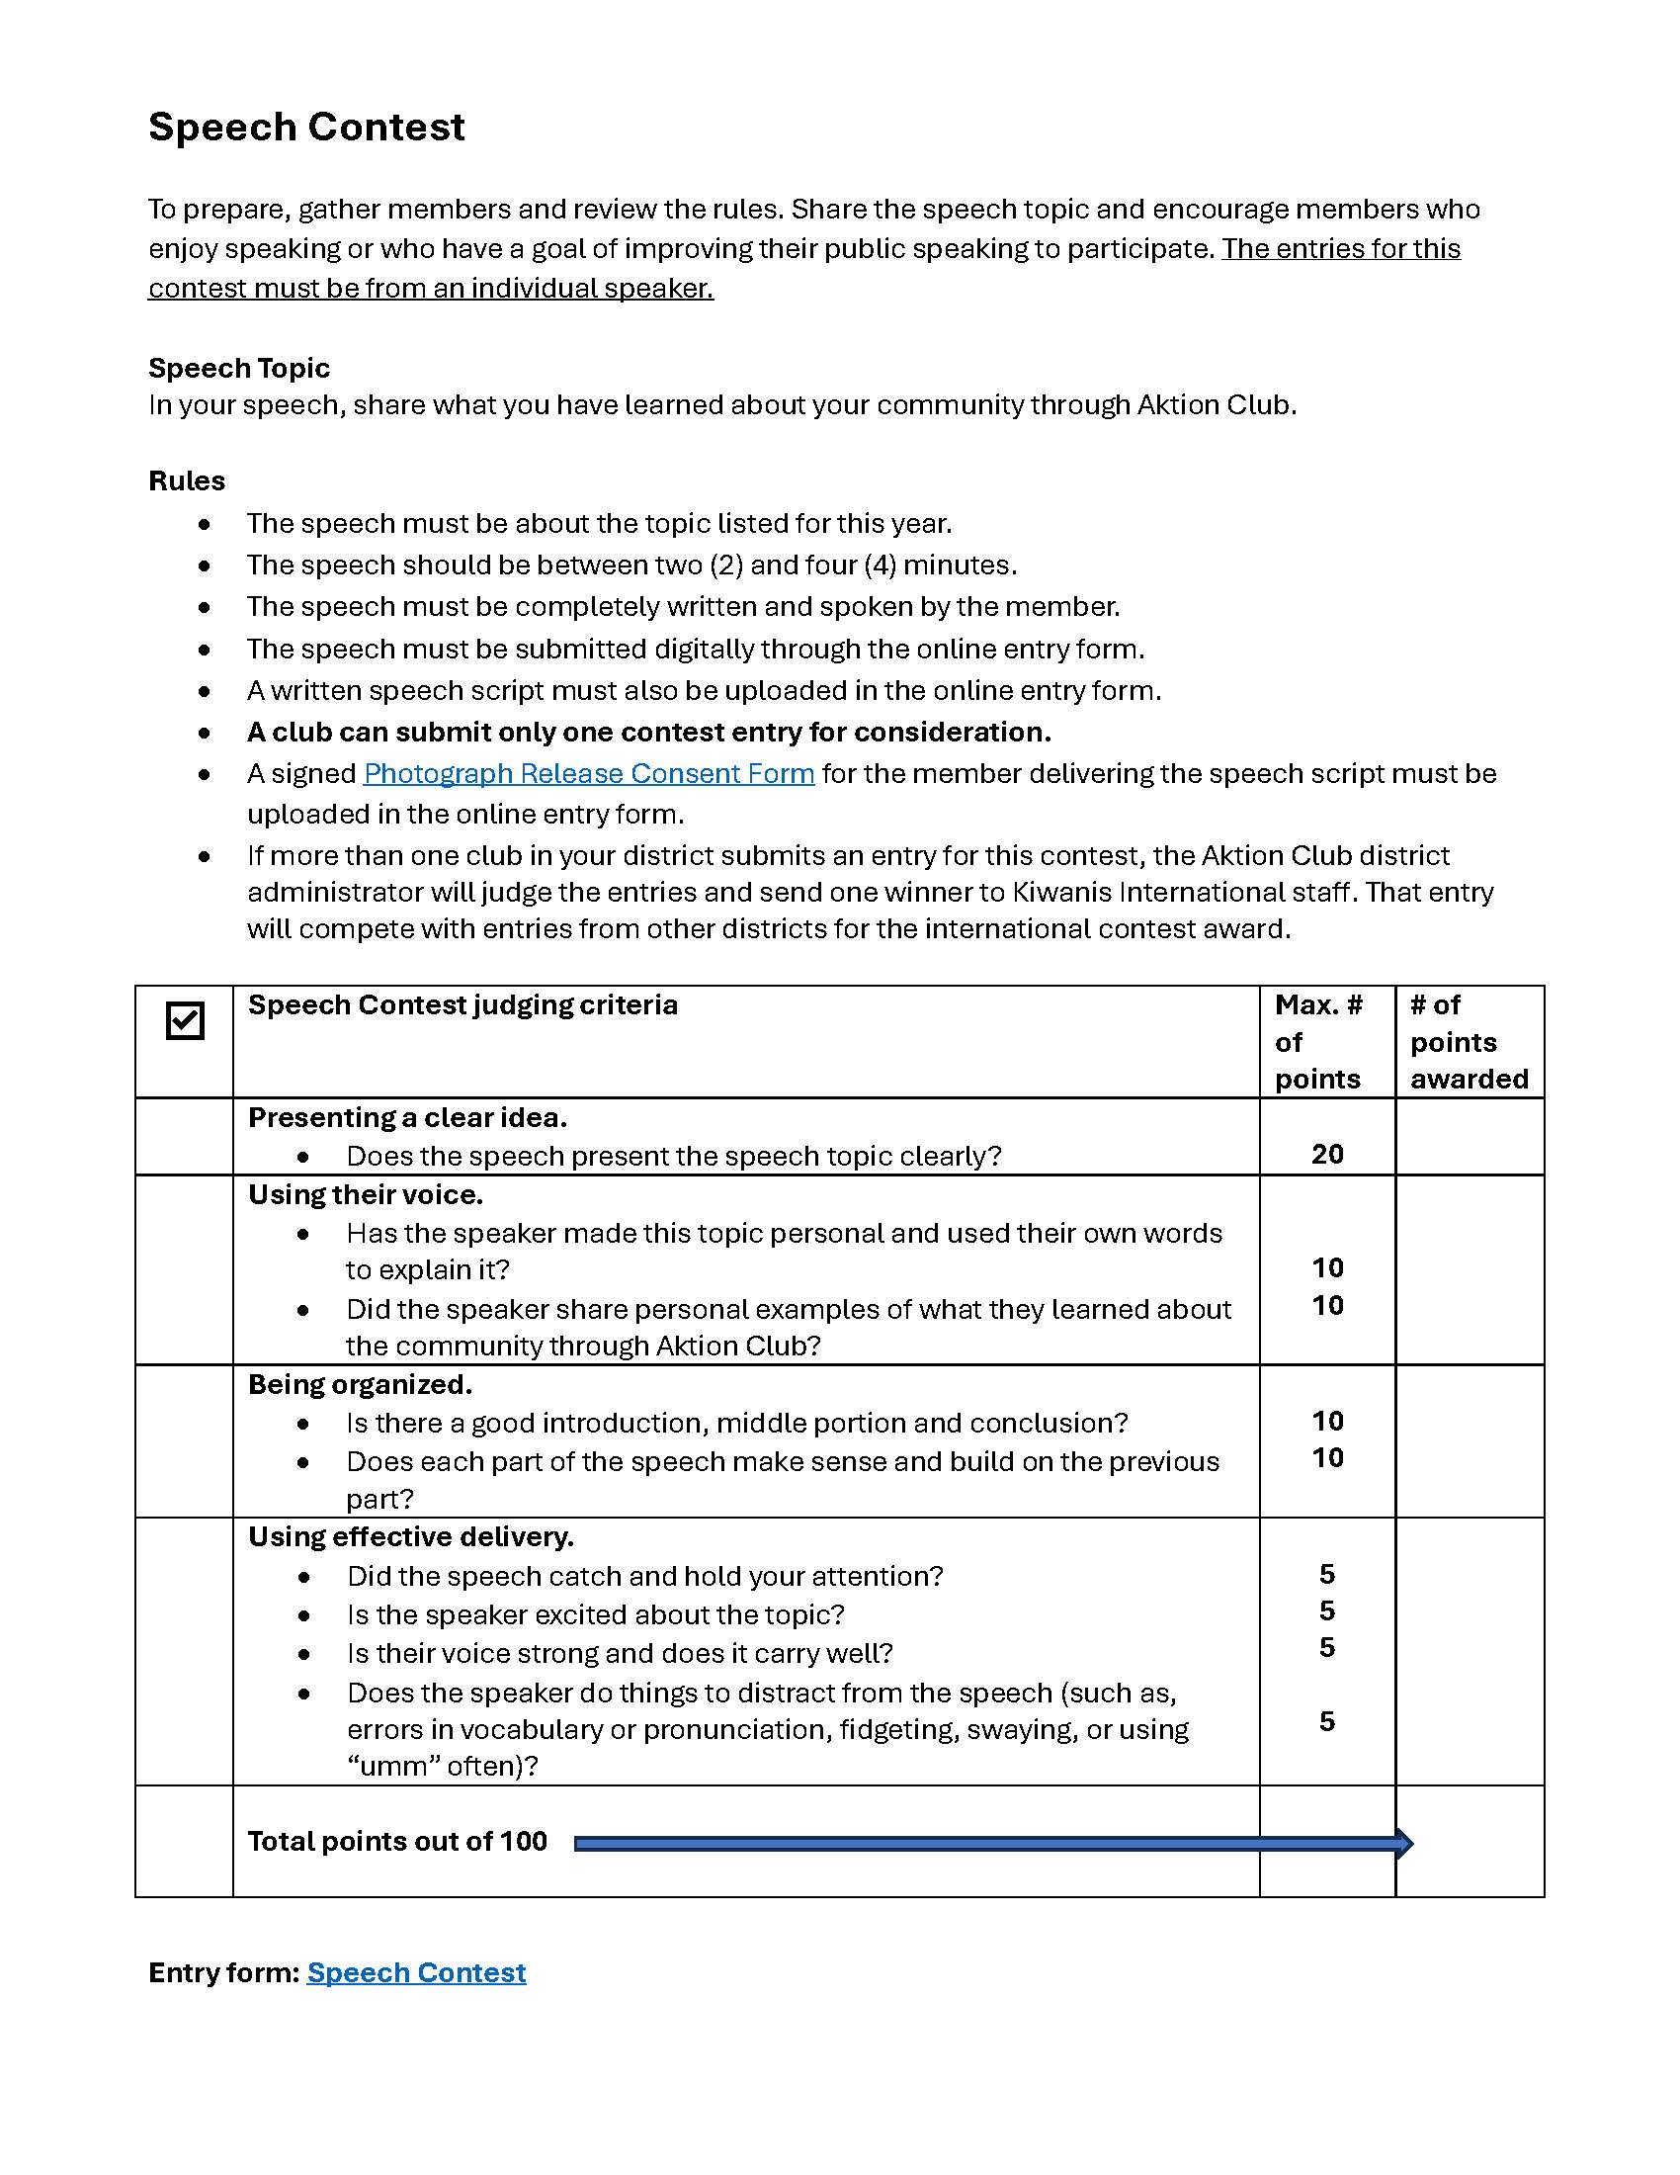
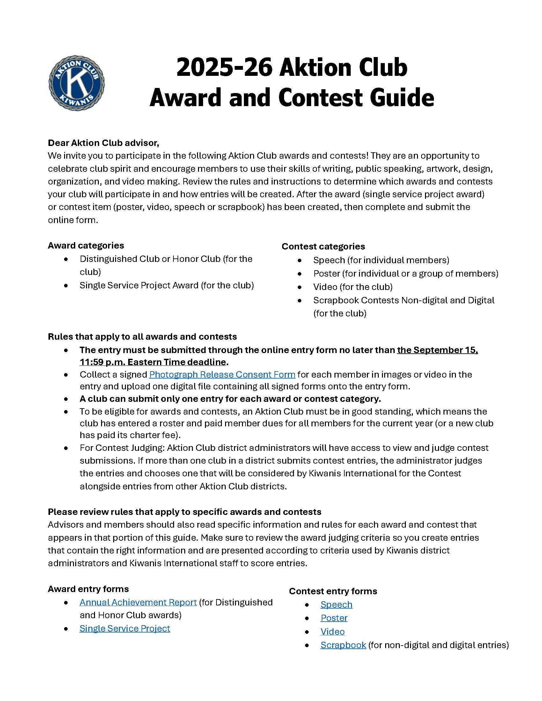
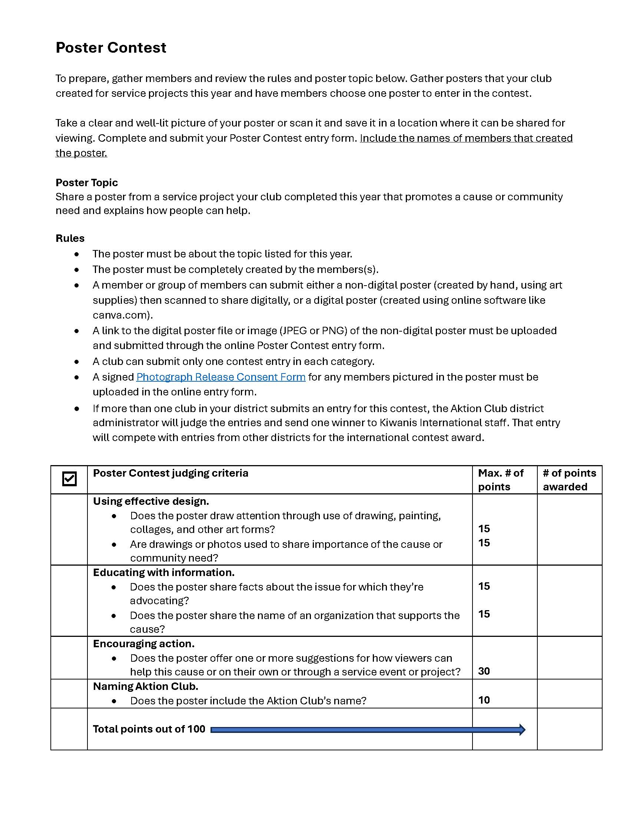
Award and Contest Guide
Visit: www.AktionClub.org/awardsandcontests

Slide 4
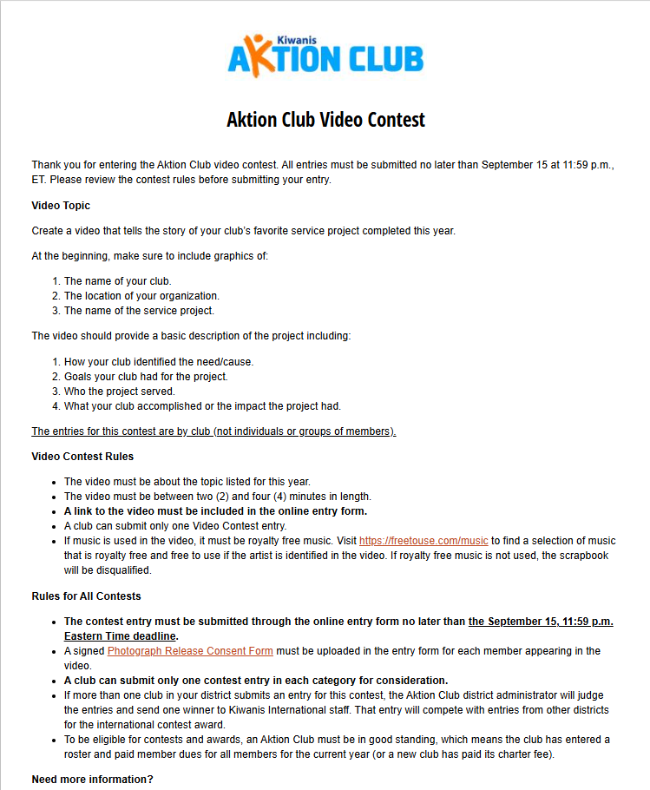
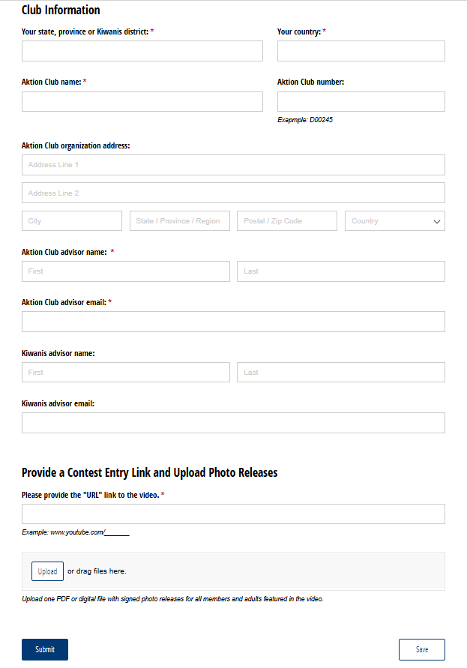
Online entry forms
Visit: www.AktionClub.org/awardsand contests

Slide 5




Contest Categories

Slide 8
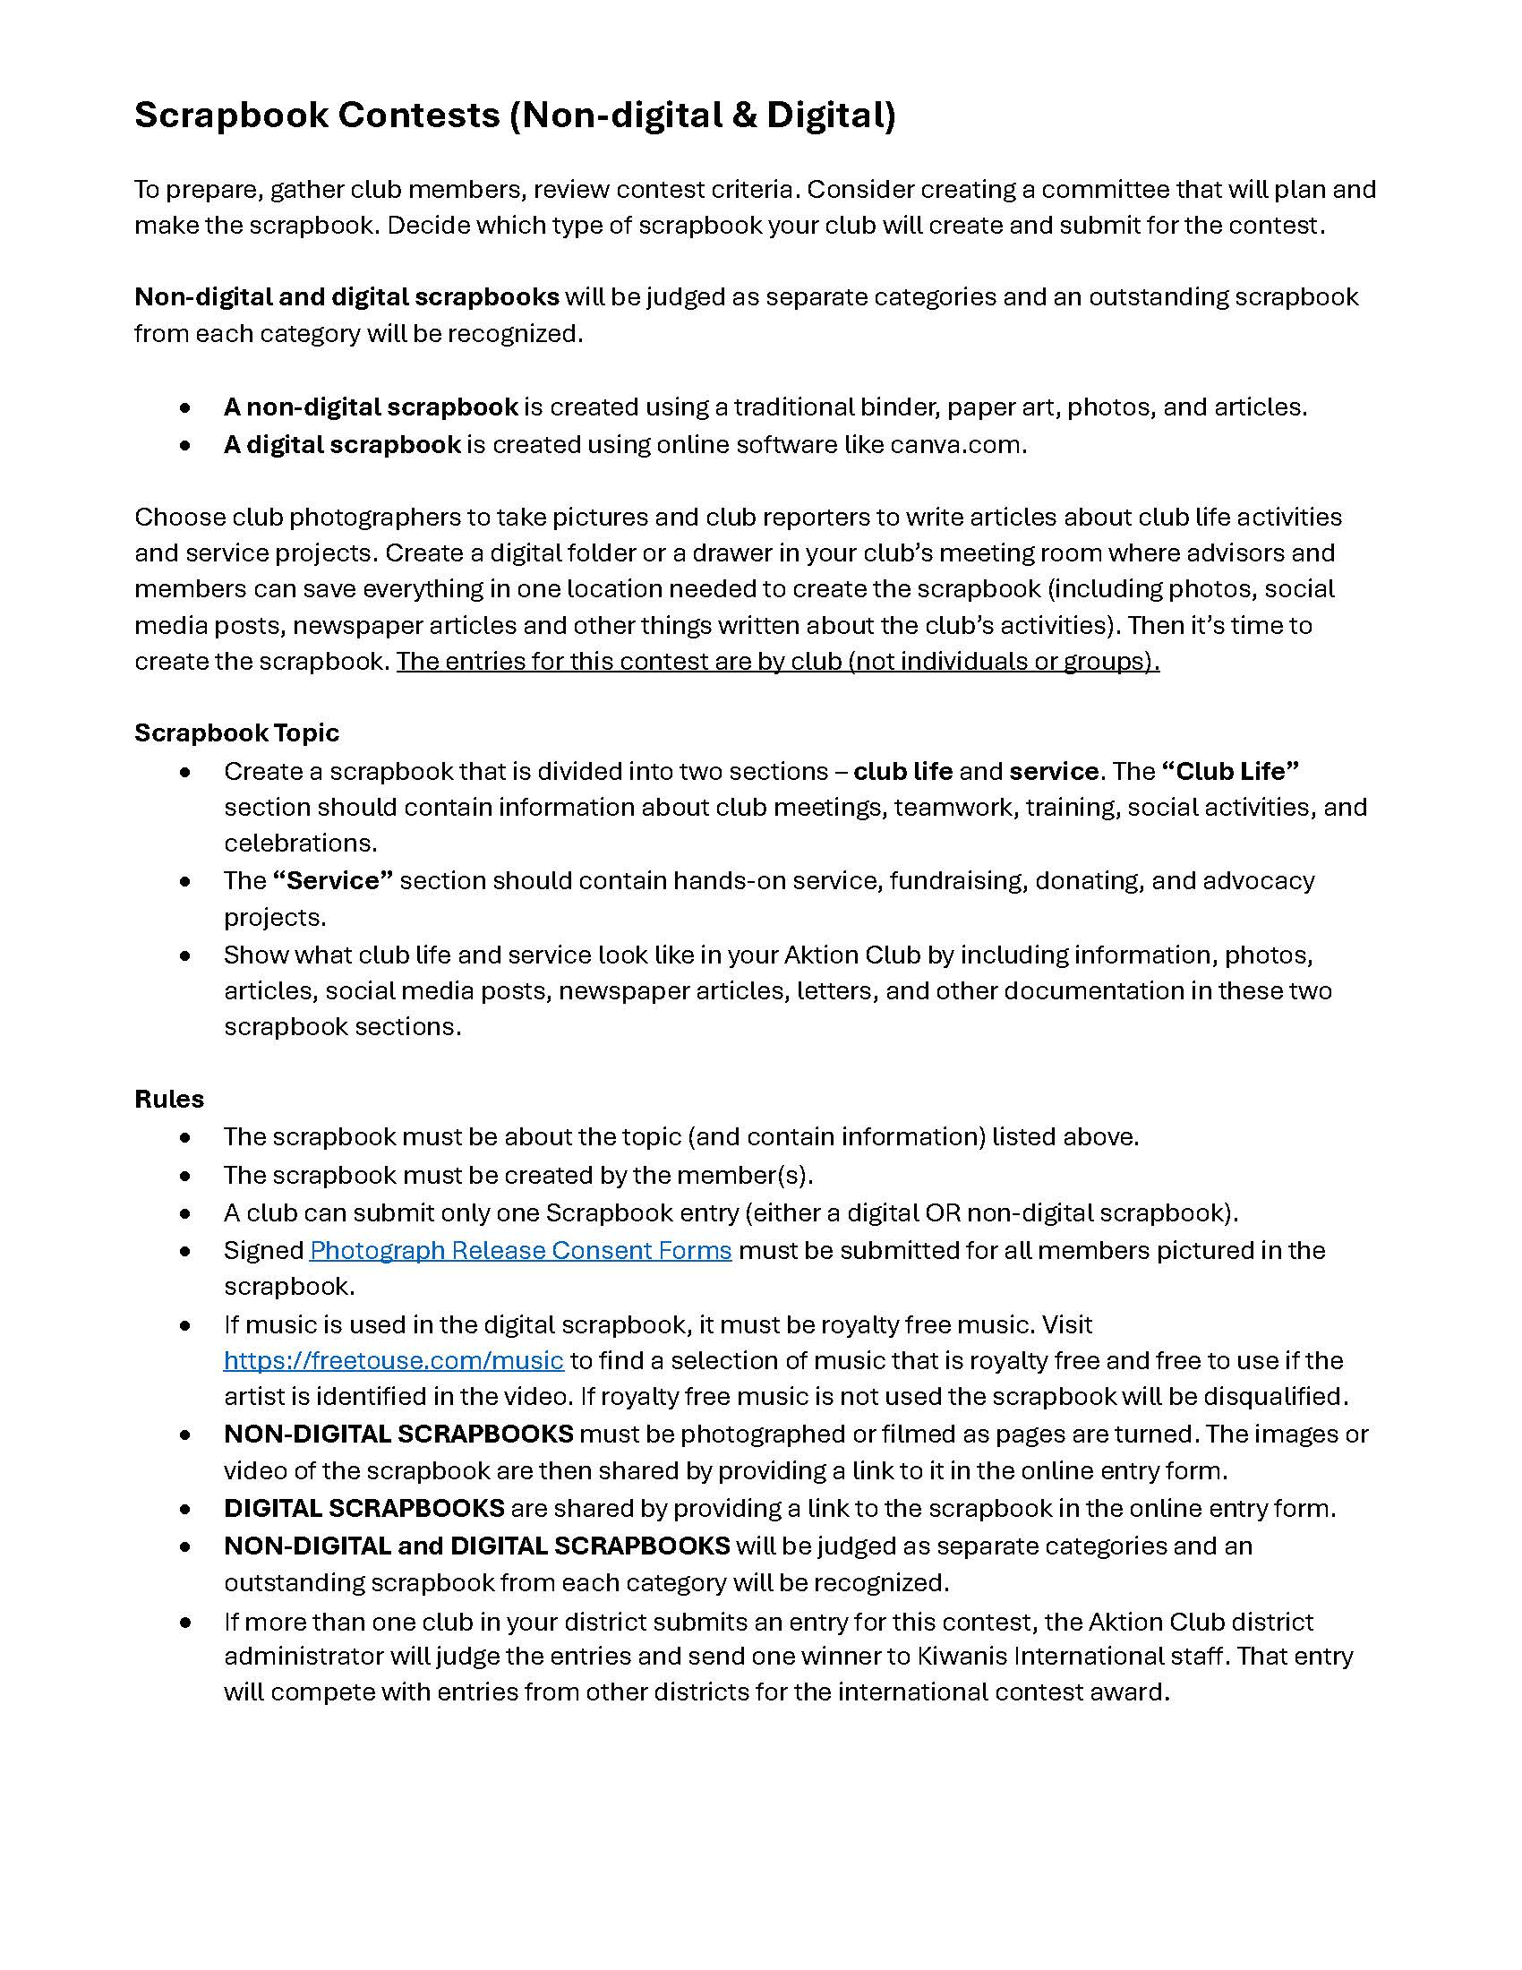
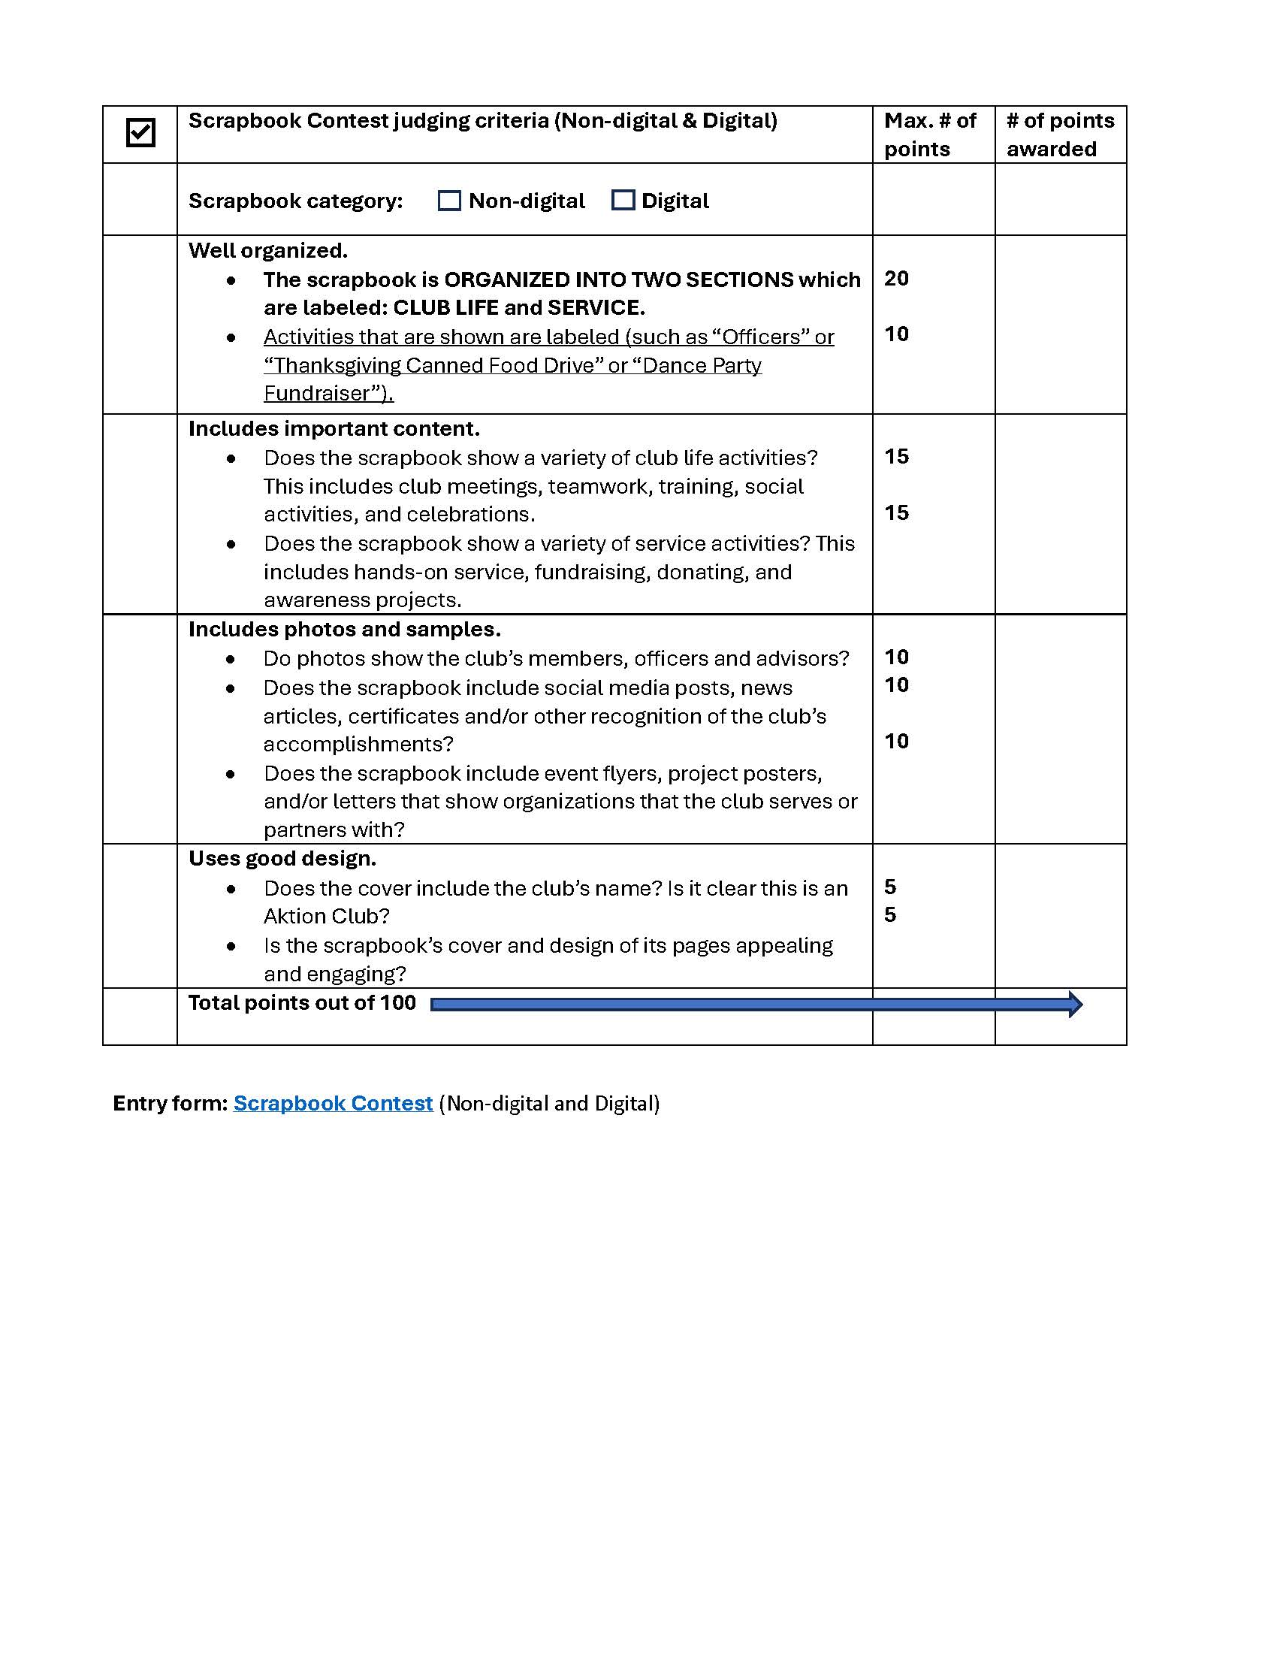
NEW THIS YEAR!
Non-digital scrapbooks will no longer be mailed to Kiwanis International and to district administrators!

Slide 9
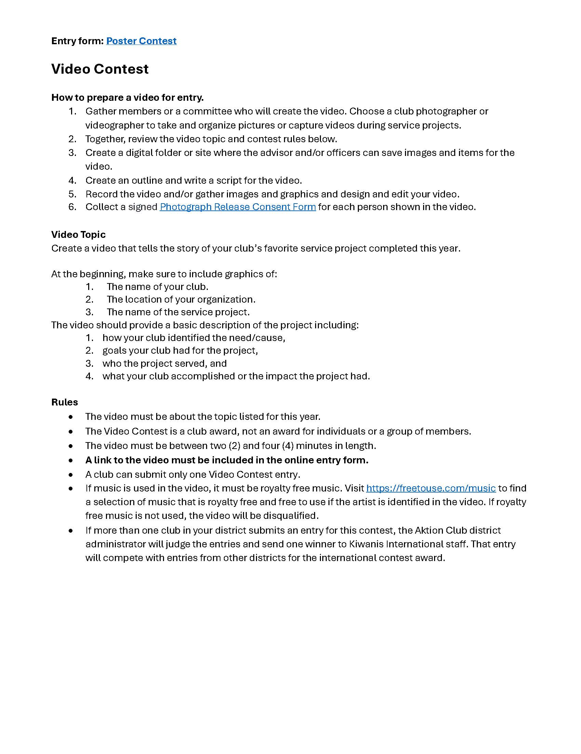
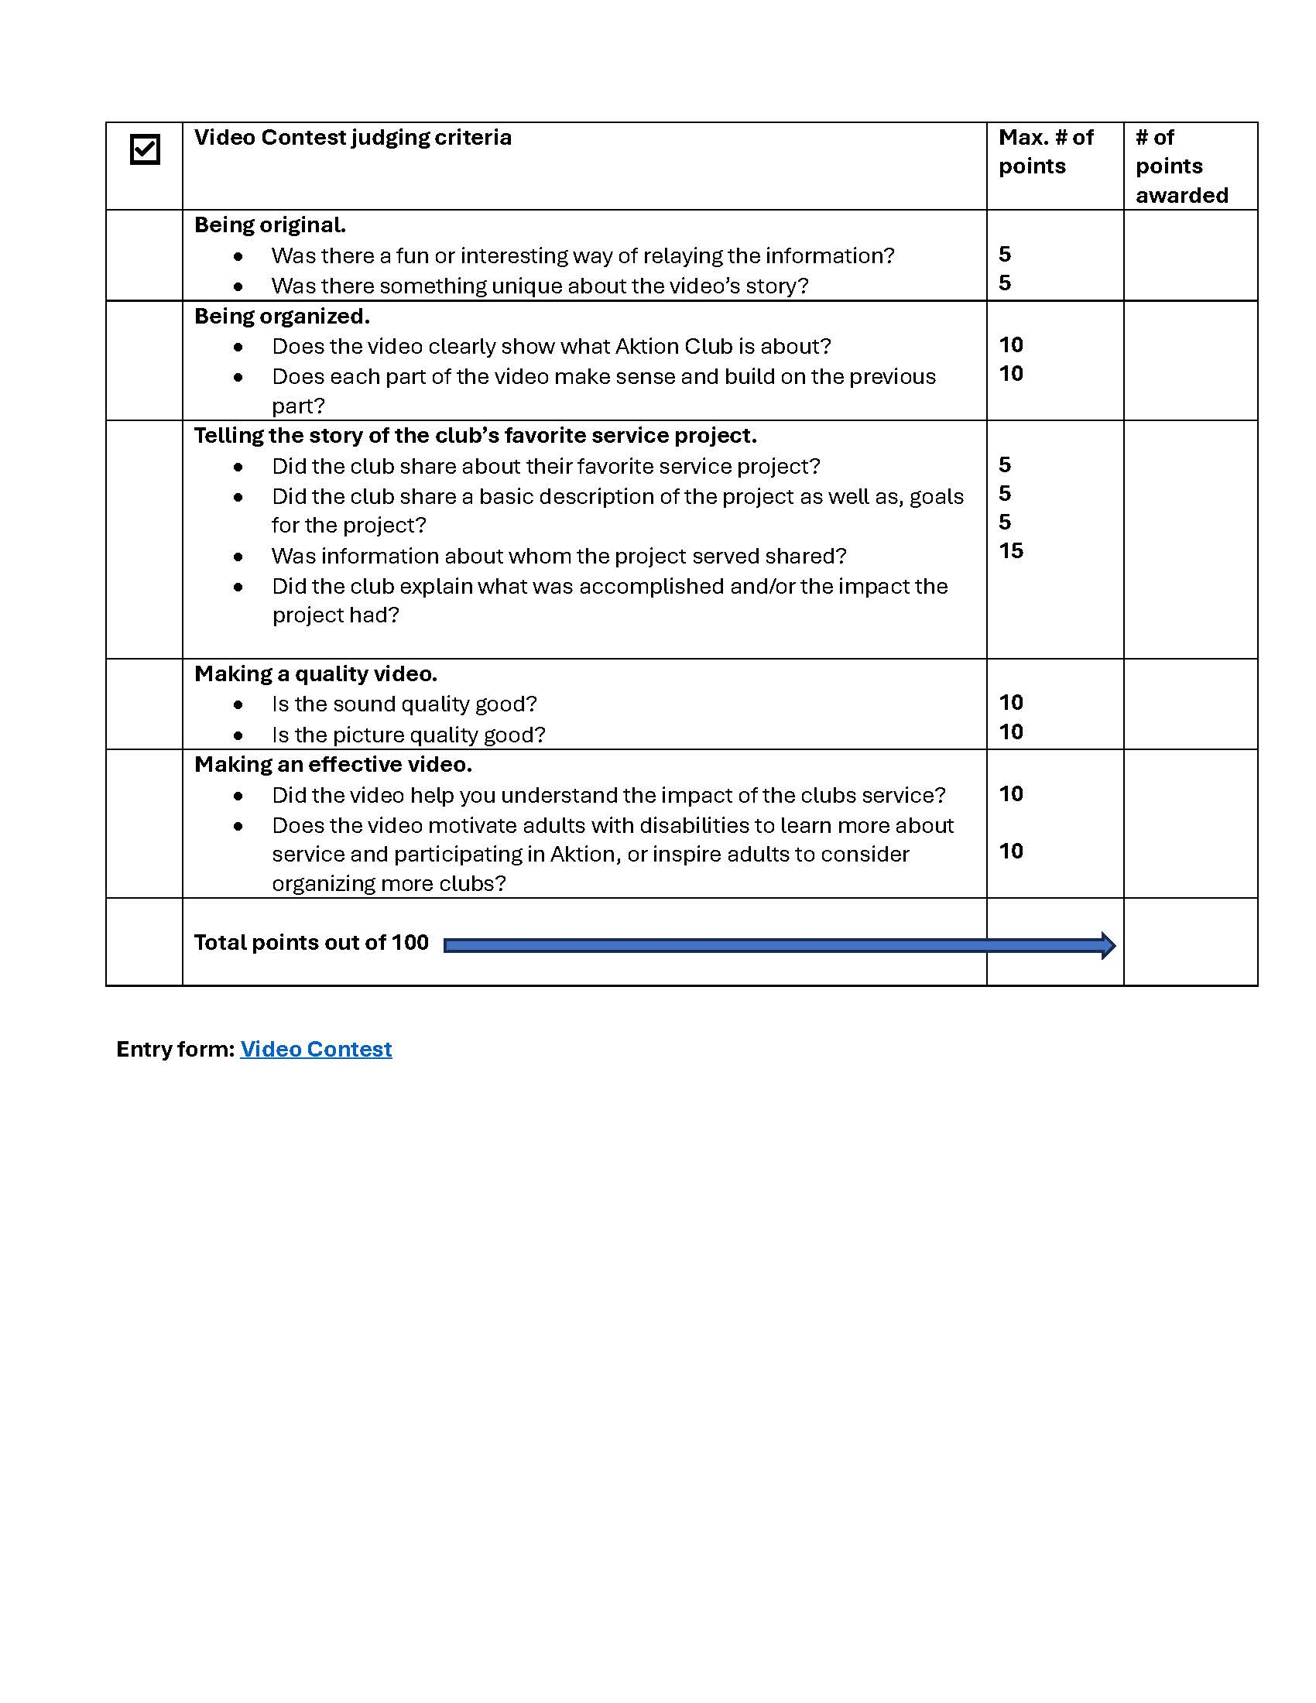
Notes:
Kiwanis International is:
A program of Kiwanis International dedicated to serving the children of the world.
660,000 members in 80 countries.
Raise US $100 million each year.

Slide 10

Award Categories

Slide 11


15 to 17 points Distinguished Club
12 to 14 points Distinguished Club

Slide 12
Examples of Annual Achievement Report Questions
Does your club have 15 or more members?
Did your club have 10 or more meetings this past year?
Did your officers and/or members use parliamentary procedures to the best of their abilities?
Did your club conduct one or more service projects to benefit the community?
Did your club conduct one or more fundraising activities this year?
Did your club participate in one or more Kiwanis Family activities with your sponsoring Kiwanis club, Key Club, CKI, Builders Club and/or K-Kids club?
Did your club invite your sponsoring Kiwanis club to attend one or more Aktion Club events or meetings?

Slide 13
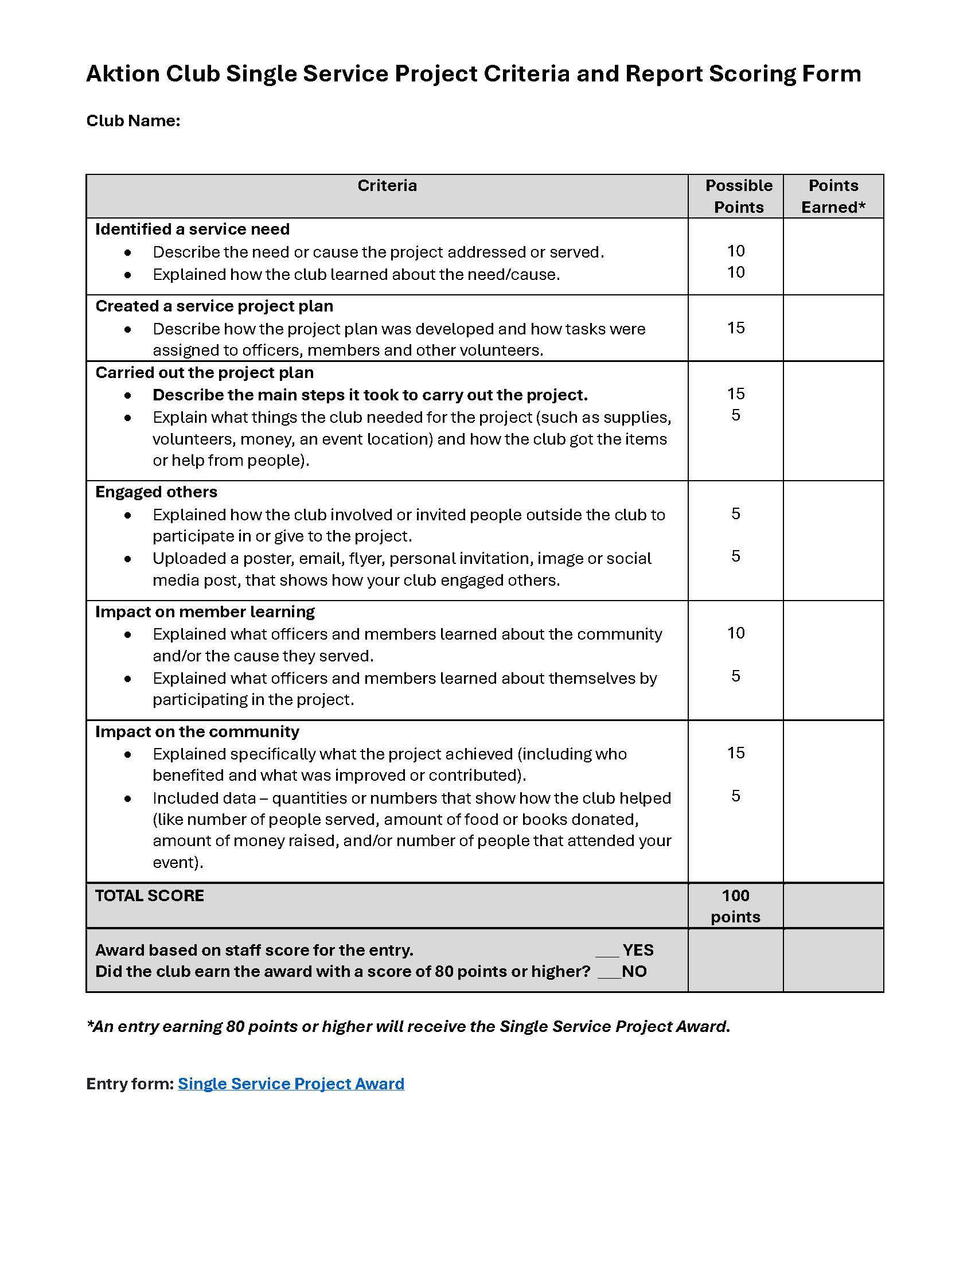

Notes:
Kiwanis International is:
A program of Kiwanis International dedicated to serving the children of the world.
660,000 members in 80 countries.
Raise US $100 million each year.

Slide 14
Recognition
One winner will be selected for contest categories. Distinguished Club, Honor Club and Single Service Project Award submissions are not competitive but do need to earn enough points to receive recognition.
Email notification announcing awardees will be sent to club advisors, Kiwanis advisors and district administrators in December.
Recognition items for some awards will be mailed to club advisors at the Aktion Club’s address in late December.
Awardees will be announced on the Aktion Club website, through the newsletter and through social media in January.

Slide 15
Questions?
Visit AktionClub.org/awardsandcontests.
We look forward to receiving your award entries
by the September 15, 2026, 11:59 p.m., ET deadline.
Notes:
Thank you. If you have questions please email aktionclub@kiwanis.org.

